Slide 1
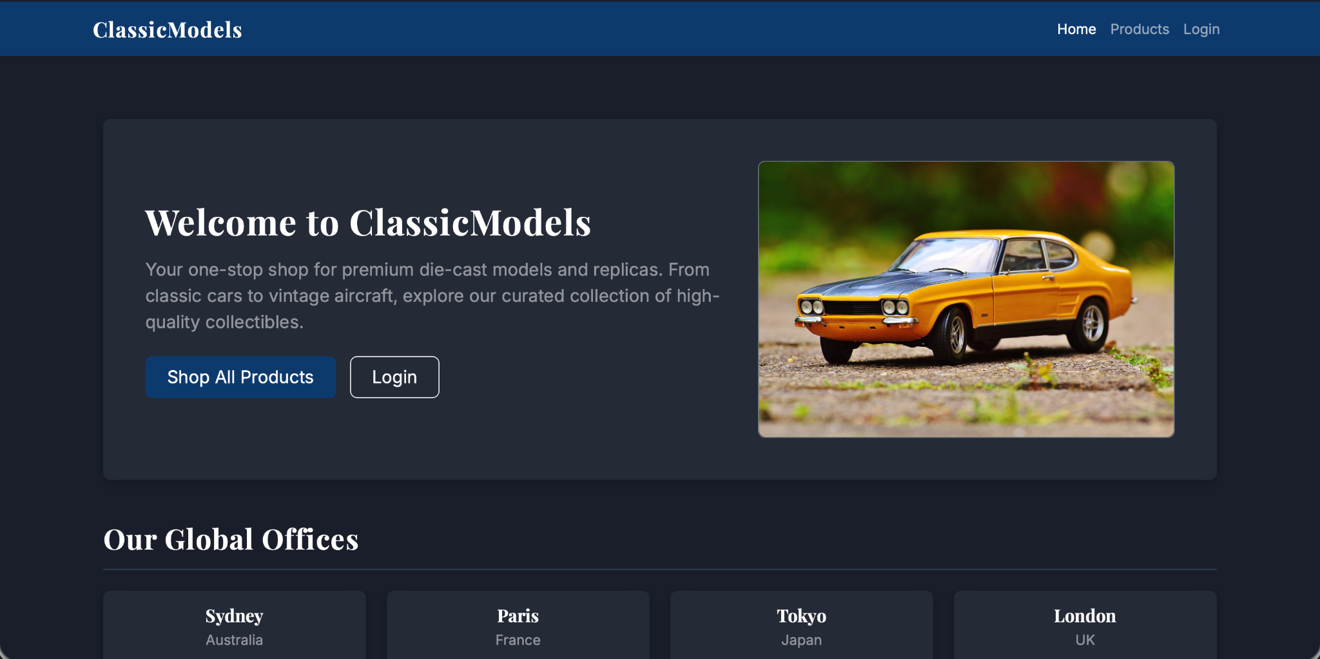
Lords of Data Project
Presentation: ClassicModels
For the BLG317E Database Systems course

Slide 2

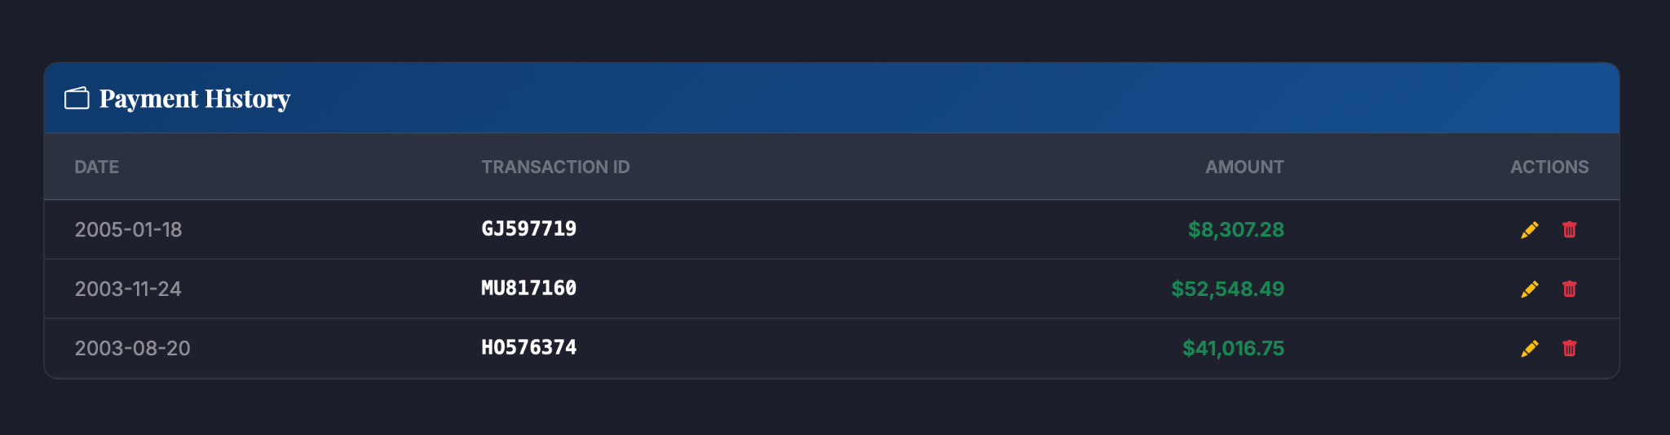
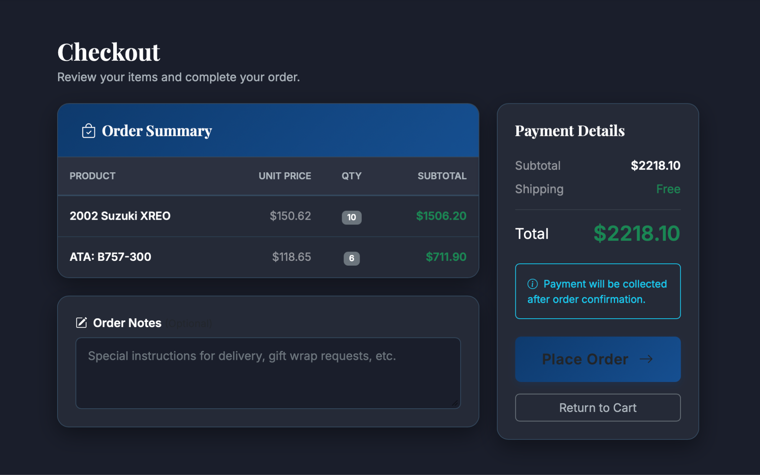
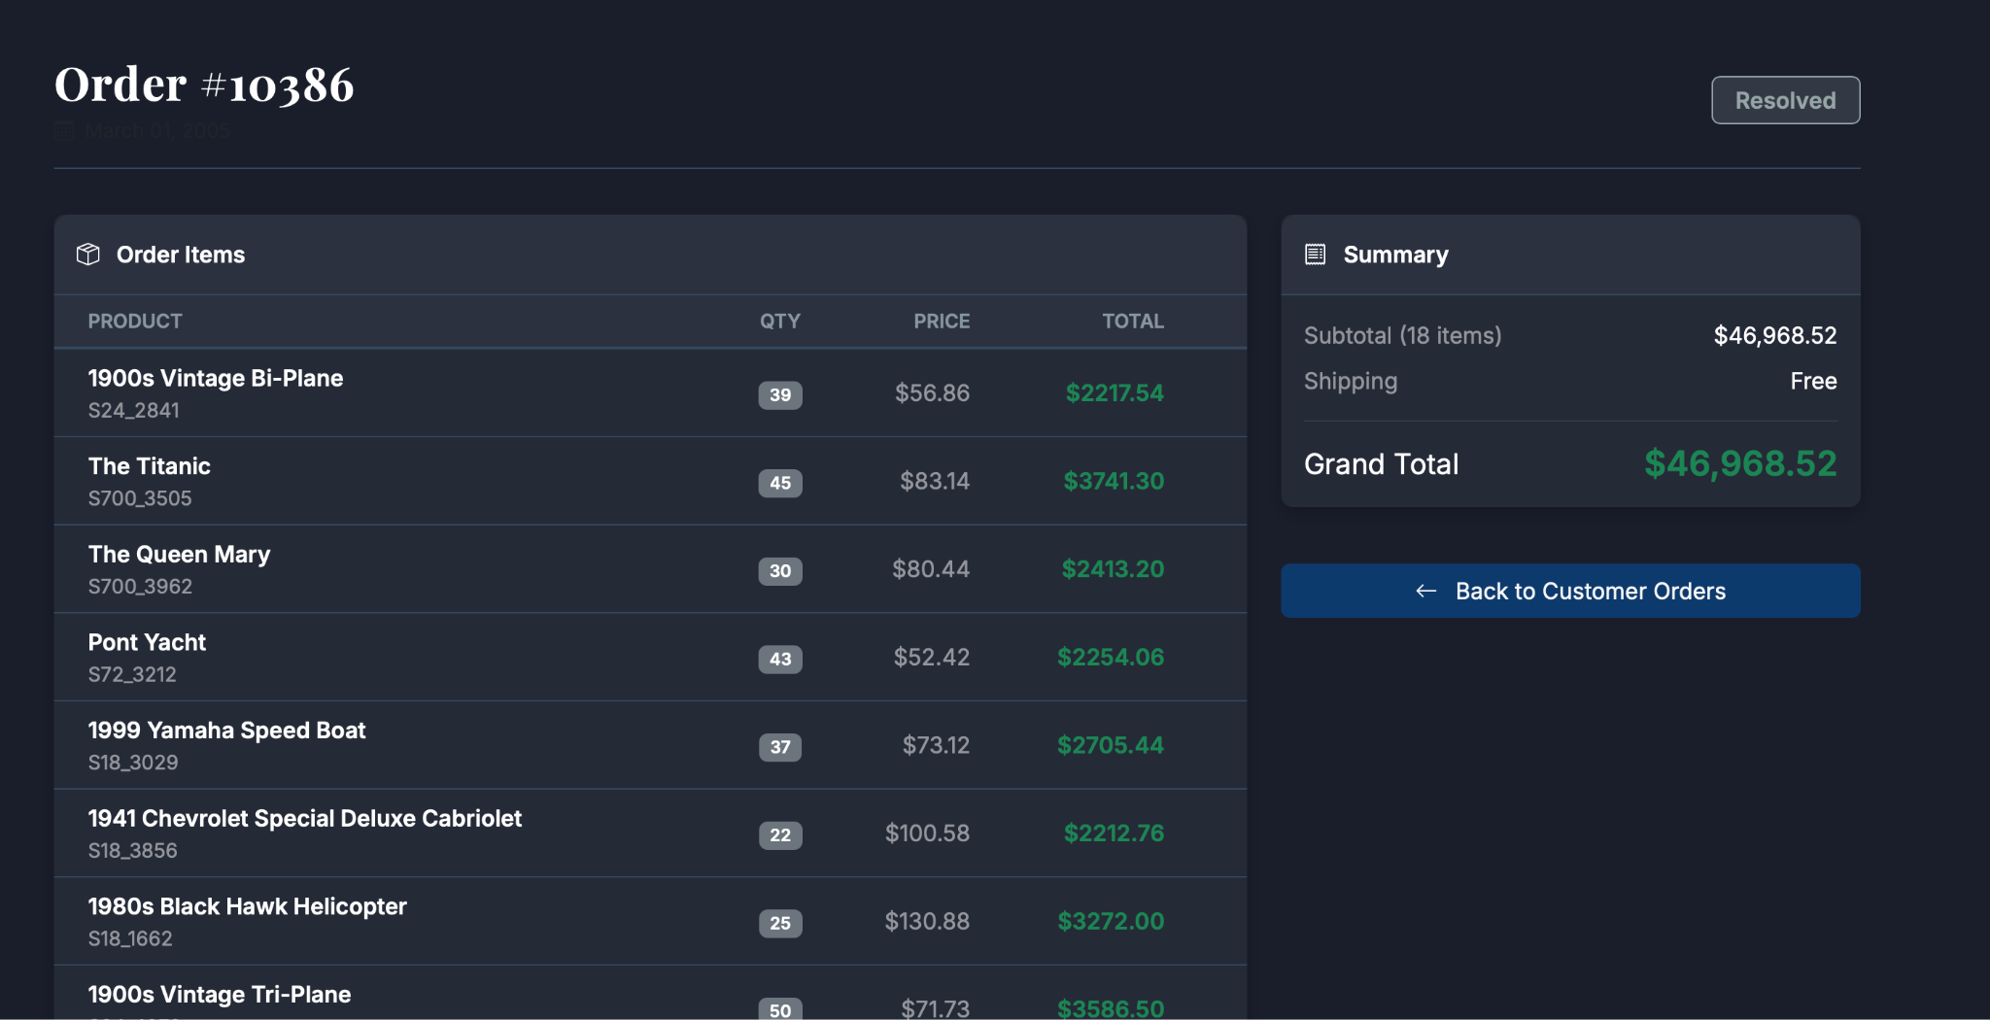
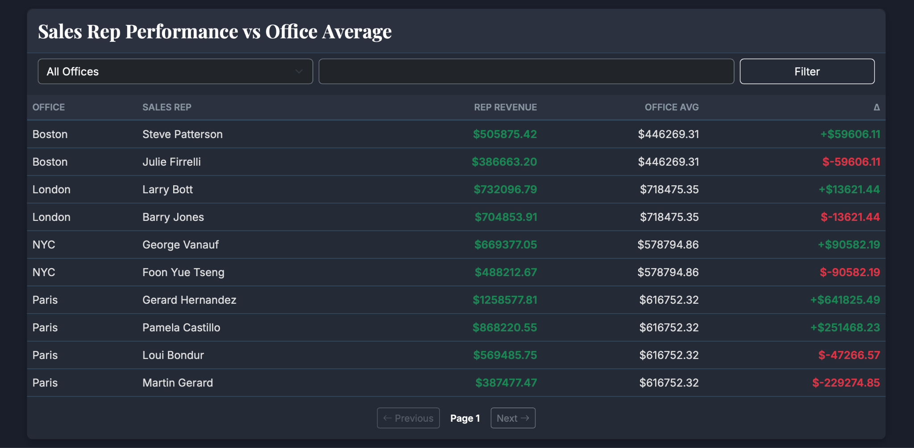
Introduction
Lords of Data consists of 5 members:
Muhammed Kağan TEMUR (150230093)
Mainly responsible for the orderdetails table, as well as the payments table.
Handled order processing logic & finance analytics.
Helped design main website layout.
Helped set up Flask routes for the website’s general flow.
Built the ER diagram.

Slide 3

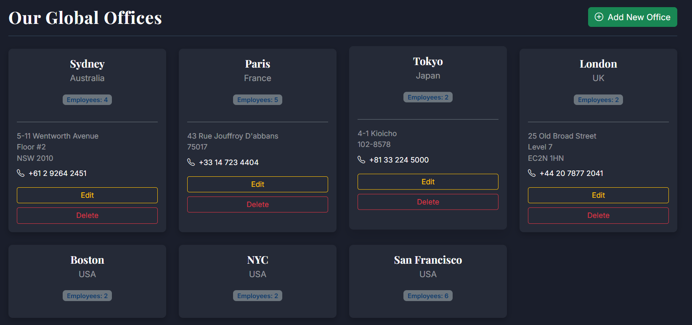
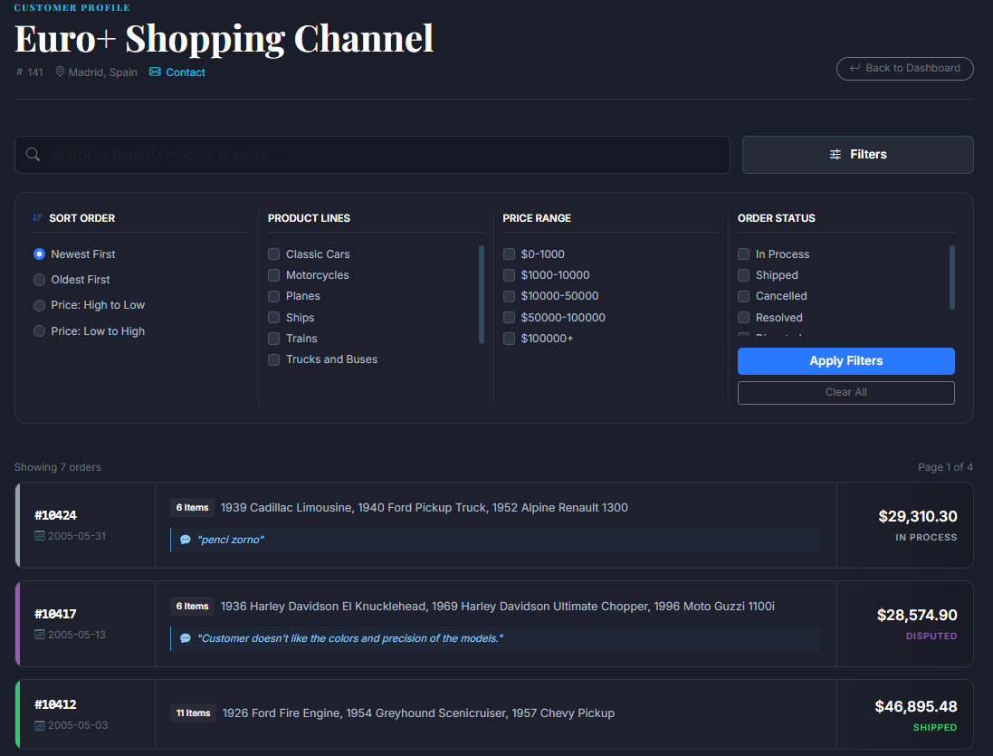
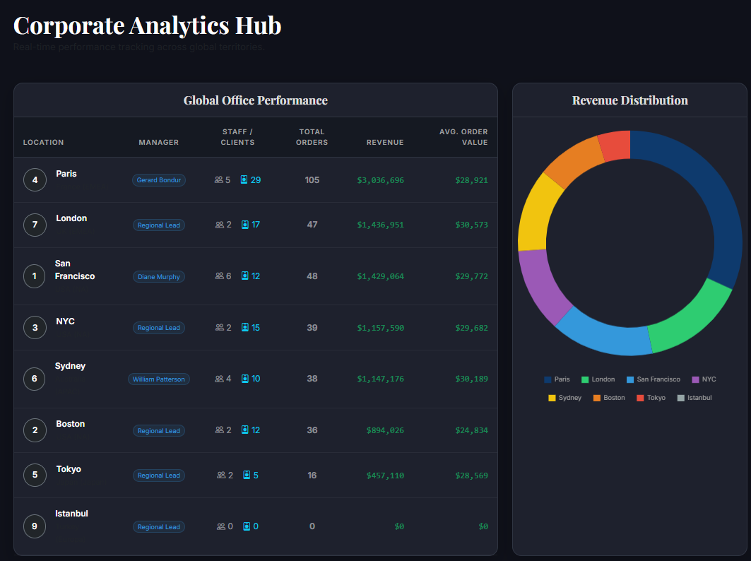
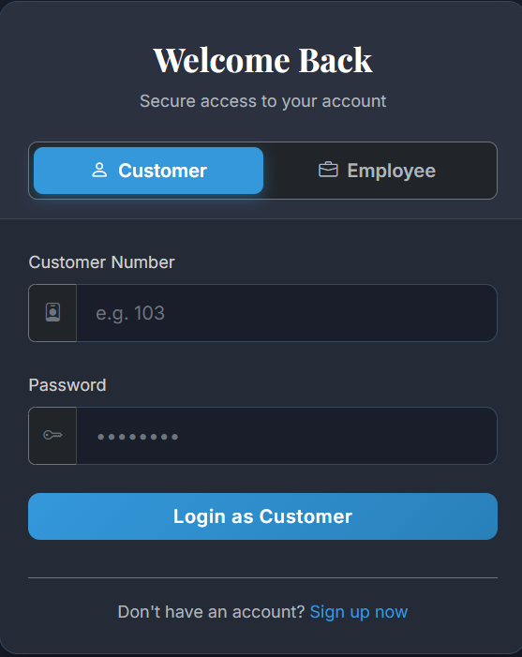
Introduction
Lords of Data consists of 5 members:
Celal GÜNDOĞDU (150230007)
Mainly responsible for the orders table ,as well as the offices table.
Order history maintaining and managing system.
Office unit system and management for employees.
Complex analytical queries relating office performance.
Search and filter implementations.
Complete password authentication system.
UI modifications.

Slide 4

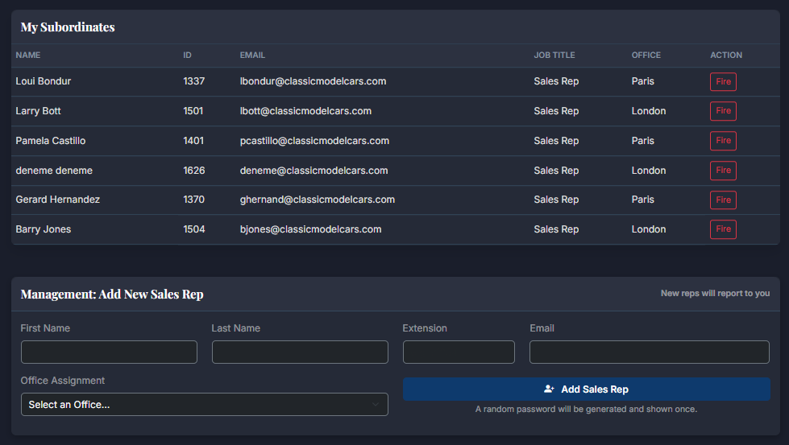
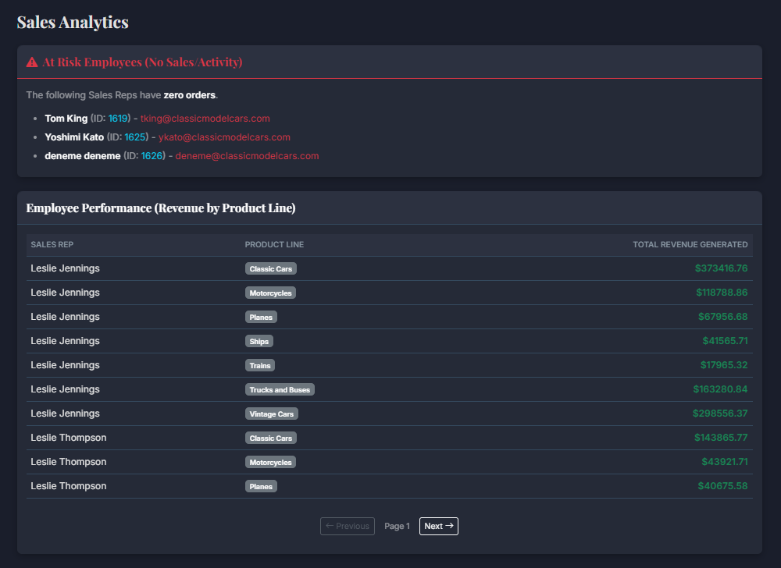
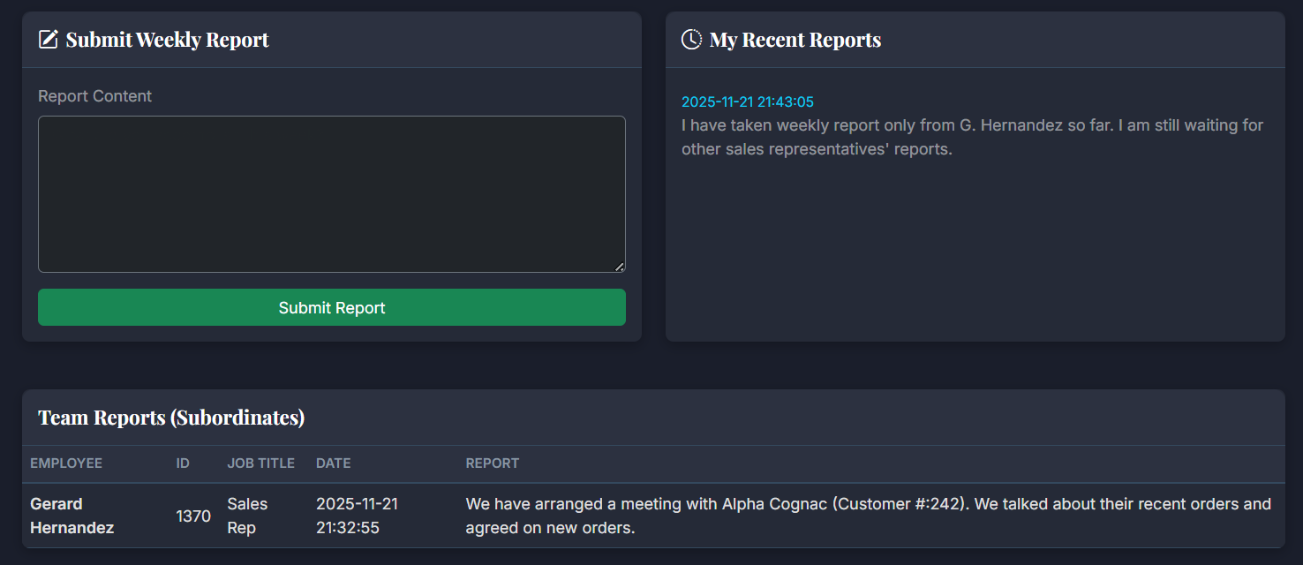
Introduction
Lords of Data consists of 5 members:
Hüseyin Hayri DEDE (150220002)
Mainly responsible for the employees table, as well as the employee_reports table.
Dashboard page
Employee hierarchy
Employee reporting system
Sales and employee performance analytics

Slide 5
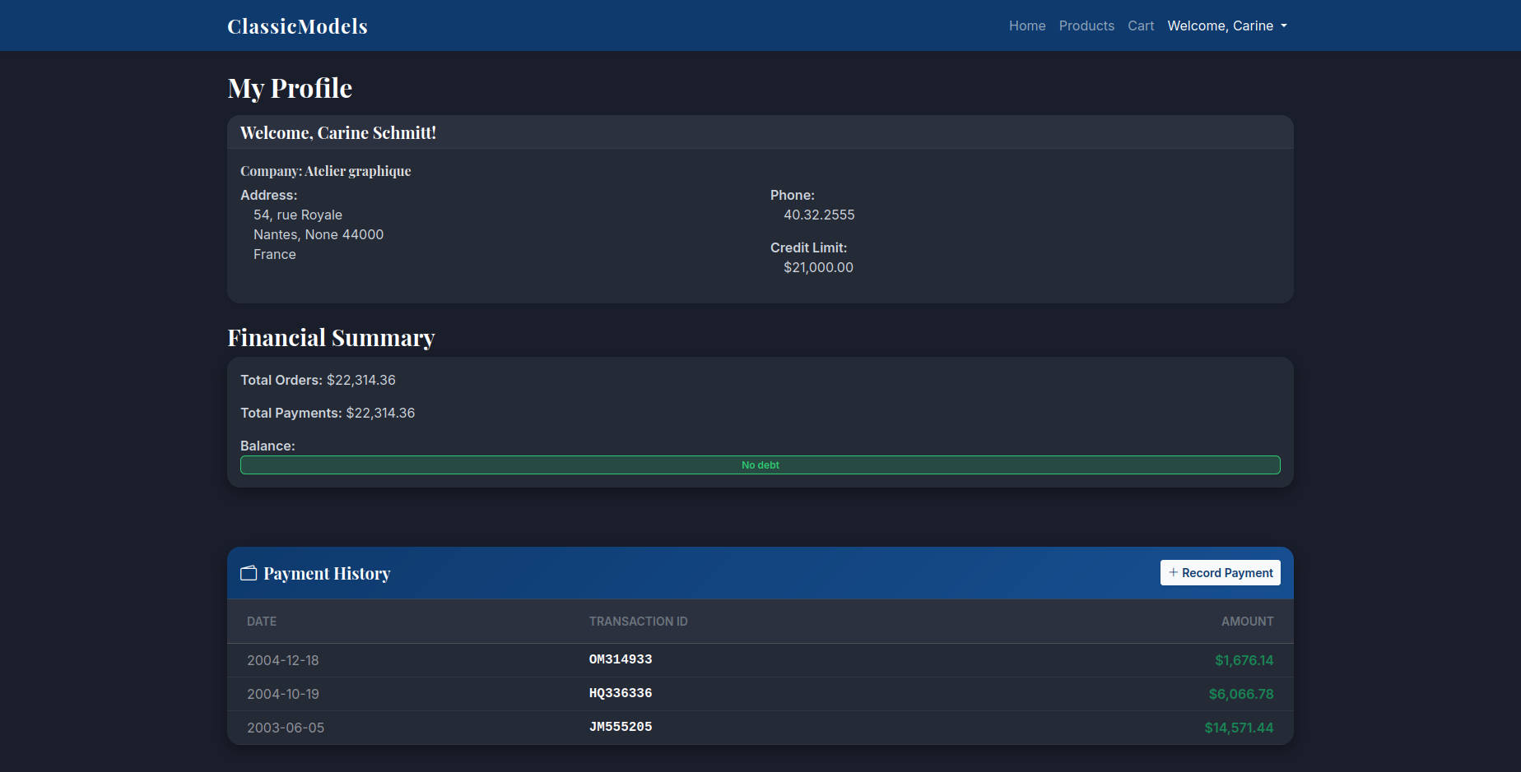

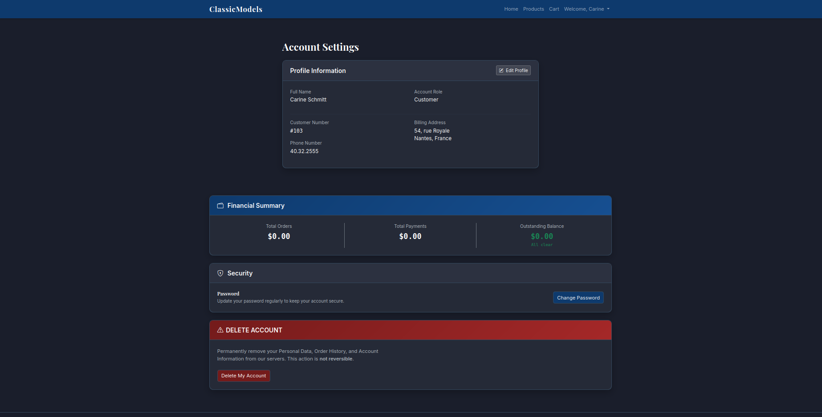
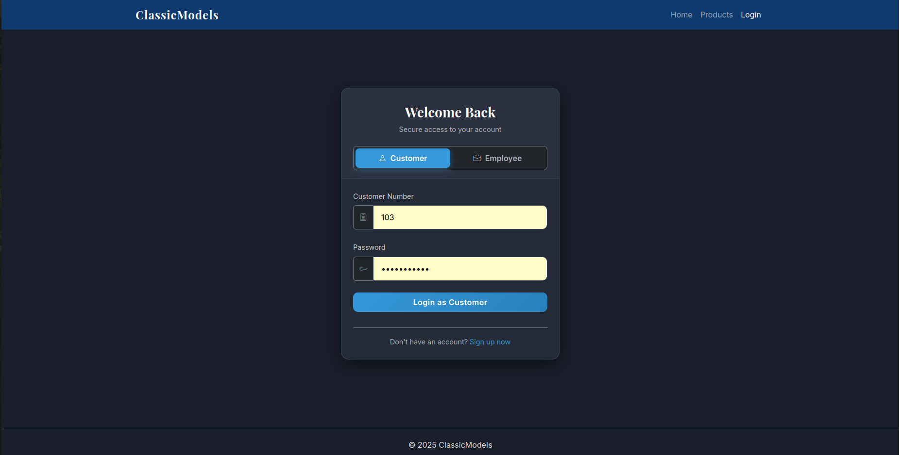
Introduction
Lords of Data consists of 5 members:
Ahmet Said Genç (150220092)
Mainly responsible for the customer table.
Login page
Feel lucky page
Search and sort mechanism for employees’ customer table
Customers CRUD
Product sort logic
UI enhancements

Slide 6


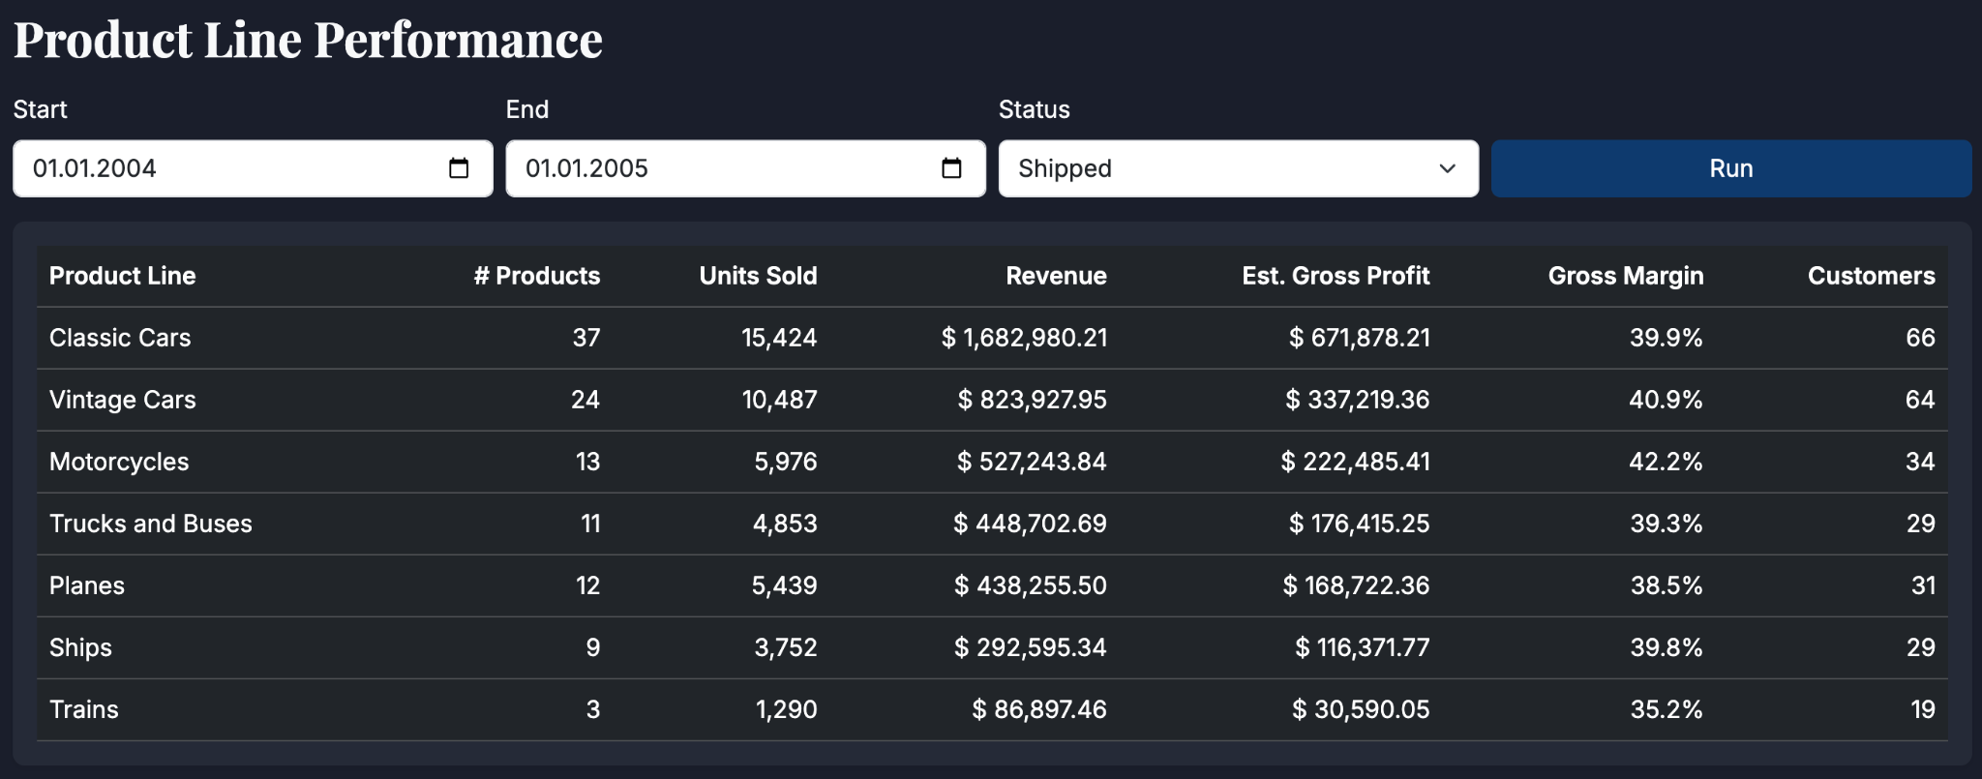
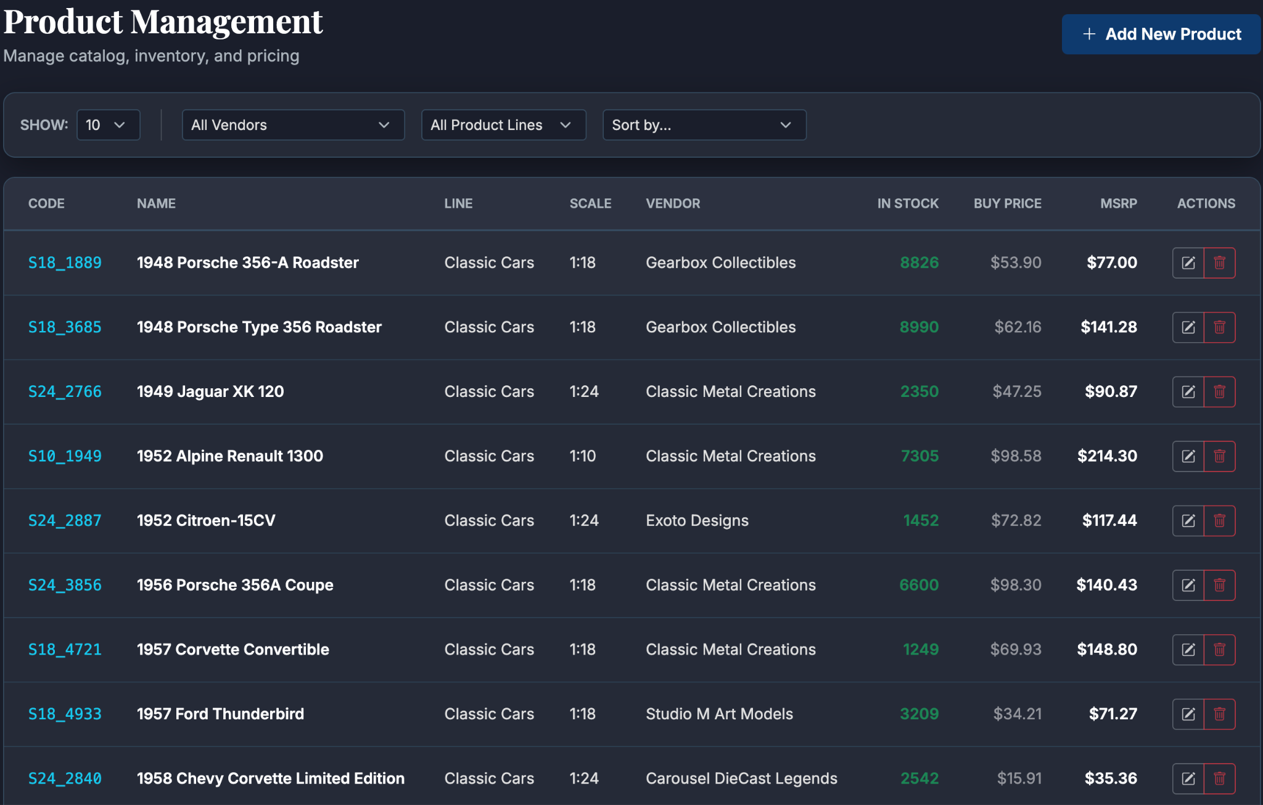
Introduction
Lords of Data consists of 5 members:
Erce Baran Keskin (070220716)
Mainly responsible for the products table, as well as the productlines table.
Contributed to the Products, Manage Products, and Product Line Report pages.
Performed performance analytics per product line.

Slide 7
Overview of ClassicModels
ClassicModels is a relational database-powered full-stack web application for a retailer of scale models (classic cars, motorcycles, planes).
The motivation behind its creation was to automate an otherwise poorly managed system. Our application utilises MySQL and Flask to fasten procedures.
The goals of the project were:
To build distinct portals for Customers, Employees, and Managers for security.
To create data-driven real-time analytics depending on sales data to make it easier for managers to interpret their data.
To enforce business rules at the database level.
To remove manual calculation errors.
To optimize storage and access.

Slide 8
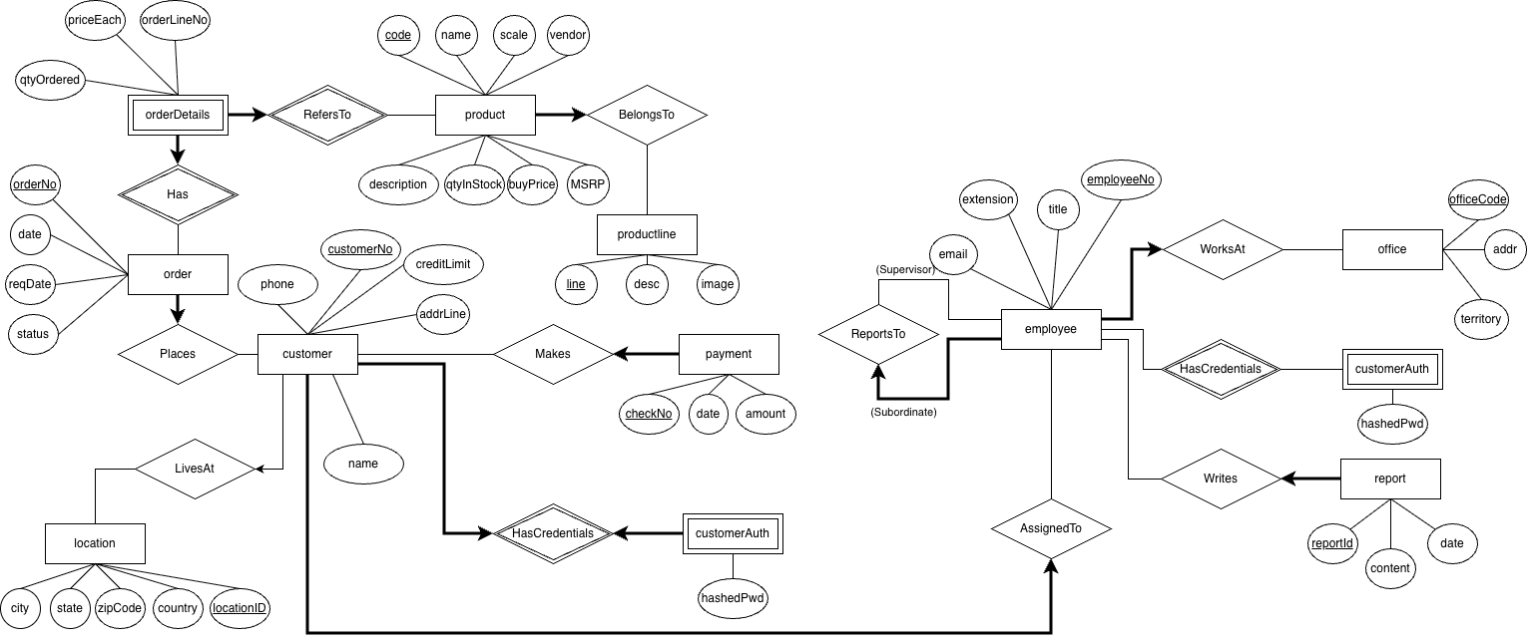
Full ER Diagram (Chen Notation)

Slide 9
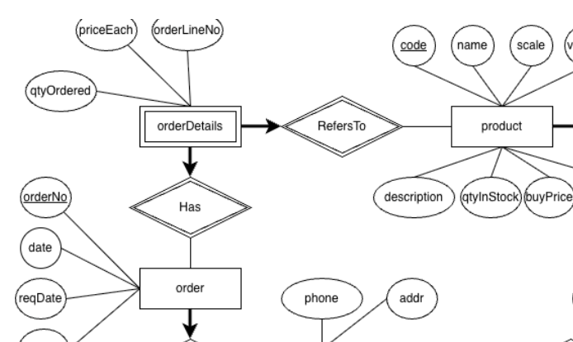
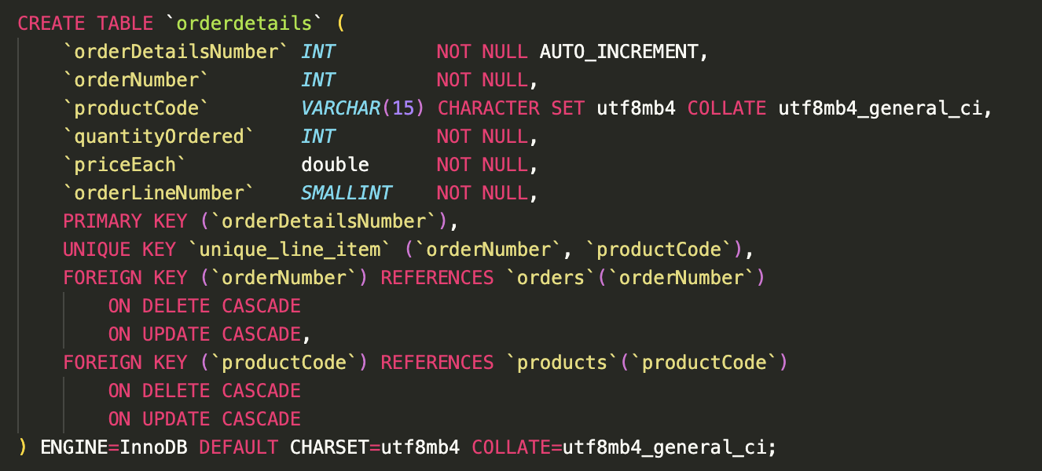
ER-to-Relational Mapping
The orderdetails entity is a weak entity that is used to resolve the many-to-many relationship between product and order.
The Has and RefersTo identifying relationships were built into this table using the orderNumber and productCode FKs respectively.
When mapping, we used a surrogate key (orderDetailsNumber) instead of relying on the candidate key alone to simplify operations.
Integrity constraints were also included to cascade changes in identification data of the order or product in the entry.

Slide 10
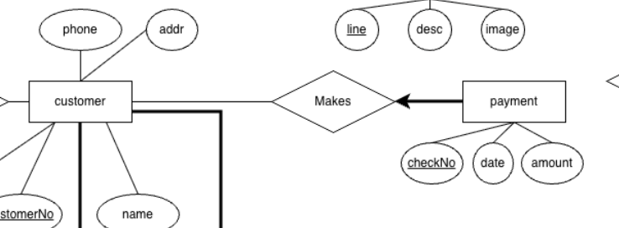
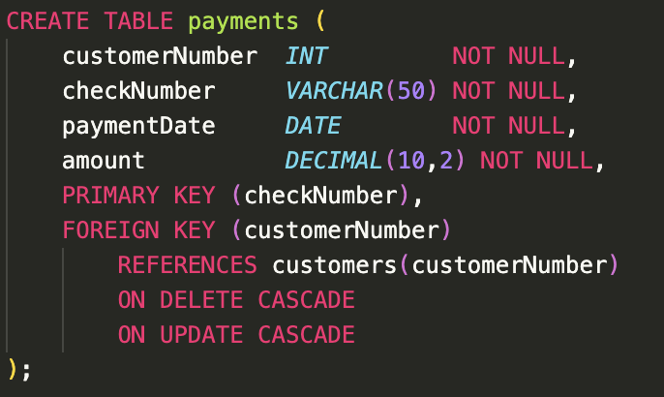
ER-to-Relational Mapping
The payment entity and the Makes one-to-many relationship were mapped to the payments table.
The relationship itself is covered by the customerNumber foreign key.
Referential integrity was enforced using ON DELETE/UPDATE CASCADE.
Since checkNumber is globally unique, we marked payments as a strong entity.

Slide 11
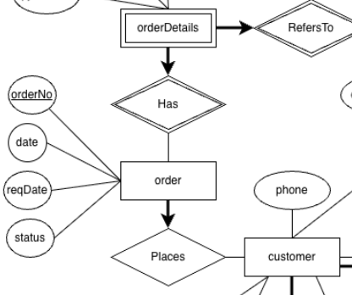
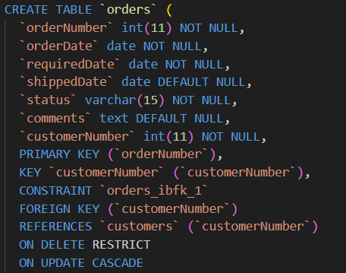
ER-to-Relational Mapping
The orders is a strong entity that represents the core purchase transaction in the system.
Places is an one-to-many relationship between orders and customers
orderNumber serves as the unique identifier derived from the ER model.Foreign Key constraints guarantee that no order exists without a valid customer.
Referential integrity was enforced using ON DELETE/UPDATE CASCADE.
Nullable attributes like shippedDate and comments correctly model optional information that may not be known at order creation time.

Slide 12
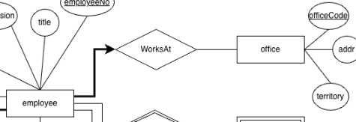
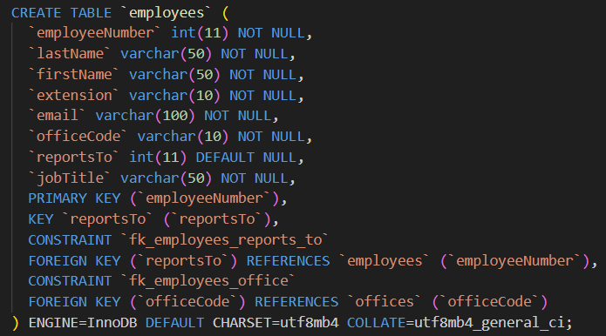
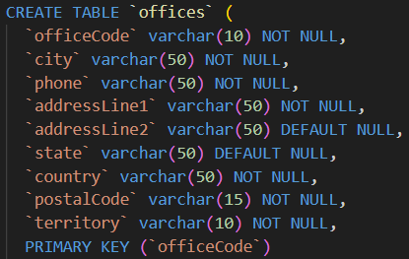
ER-to-Relational Mapping
offices is an independent entity that represents physical company locations.
officeCode serves as the unique, stable identifier derived from the ER model.Requires no Foreign Keys, ensuring existence without external dependencies.
WorksAt implements the One-to-Many relationship by placing the officeCode Foreign Key in the employees table

Slide 13
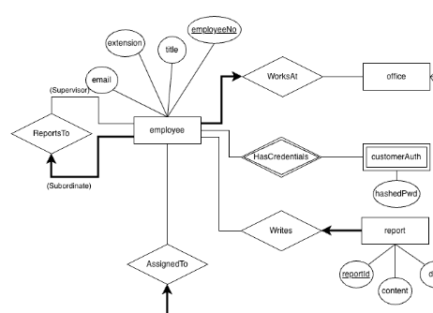
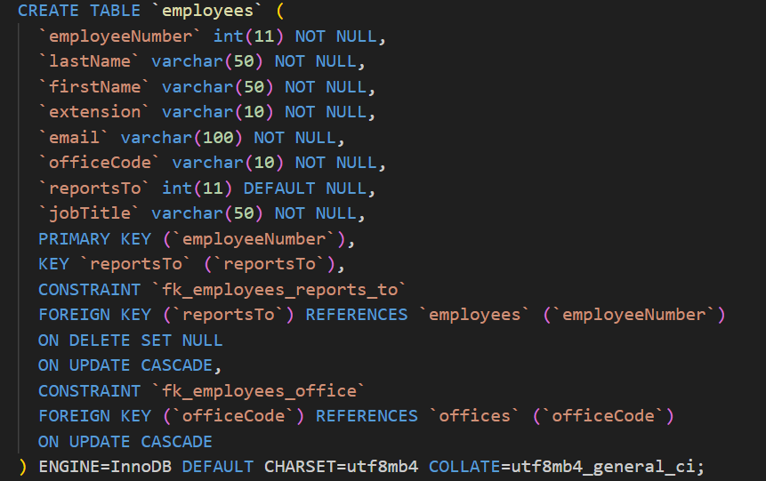
ER-to-Relational Mapping
The WorksAt one-to-many relationship were mapped to the offices table.
The relationship itself is covered by the officeCode foreign key.
Referential integrity was enforced using ON DELETE SET NULL and ON UPDATE CASCADE.
The ReportsTo one-to-many relationship were mapped to employees table itself. It forms a self referencing relationship.
Referential integrity was enforced using ON UPDATE CASCADE.

Slide 14
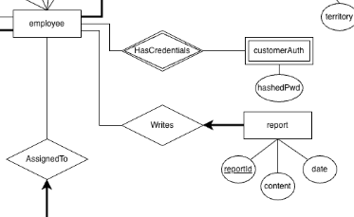
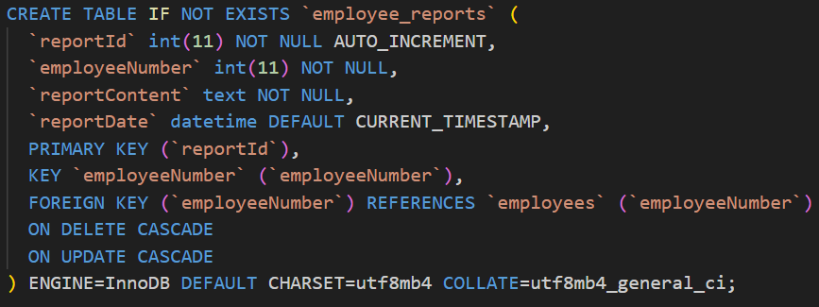
ER-to-Relational Mapping
The Writes one-to-many relationship were mapped to the employees table.
The relationship itself is covered by the employeeNumber foreign key.
Referential integrity was enforced using ON DELETE/UPDATE CASCADE.

Slide 15
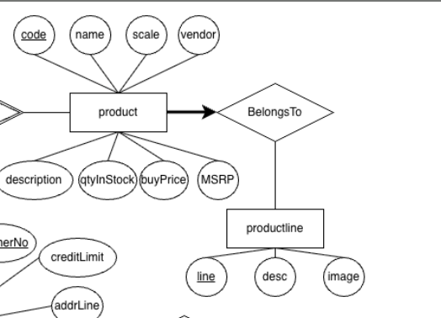
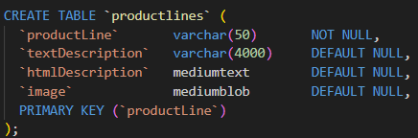
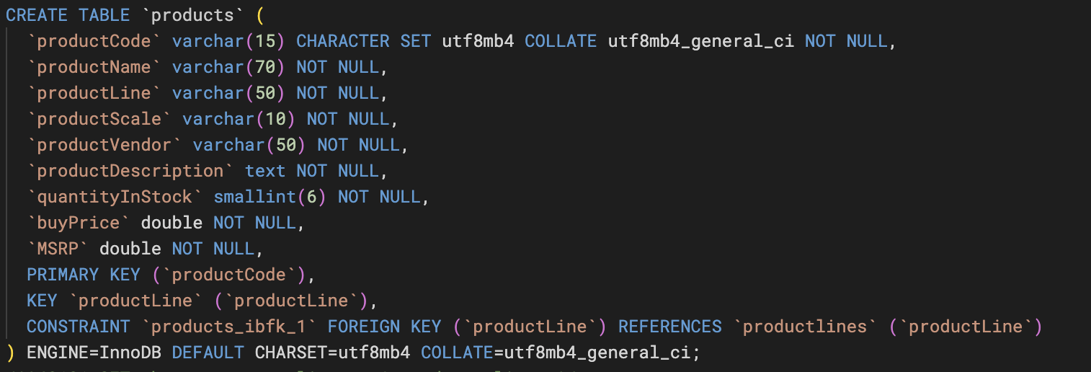
ER-to-Relational Mapping
The BelongsTo one-to-many relationship was integrated into the employees table via the productLine FK.
productlines is a strong entity that represents the types of products the retailer sells.

Slide 16
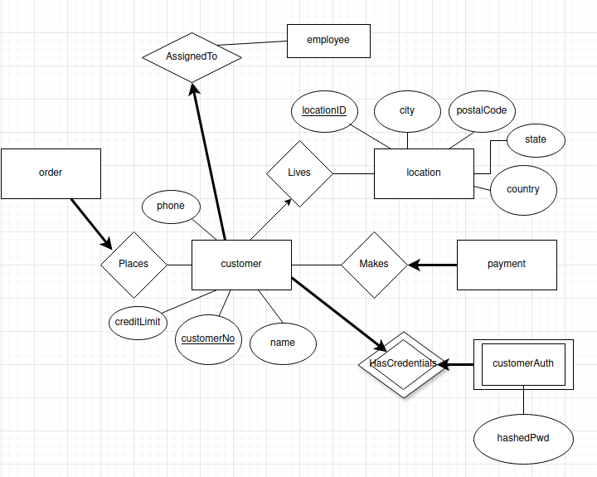
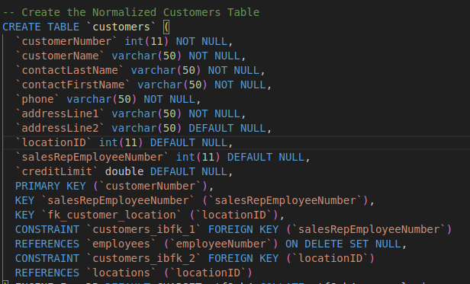
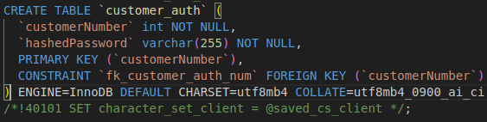
ER-to-Relational Mapping
The Lives one-to-many relationship was mapped by placing the primary key of Location as a foreign key in the Customers table.
This enforces referential integrity while allowing multiple customers to share the same location, resulting in a normalized design

Slide 17
Normalization
The orderdetails table is already in BCNF, because:
1NF:
All columns contain atomic values.
All rows are unique.
There are no repeating groups.
2NF:
There are no partial dependencies, this is because it has only one primary key.
Even if we considered the candidate key (orderNumber, productCode), it is also free of partial dependencies.
The table is in 1NF.
3NF:
There are no transitive dependencies (non-key to non-key FDs).
The table is in 2NF.
BCNF:
Every determinant is a candidate key.
The table is in 3NF.

Slide 18
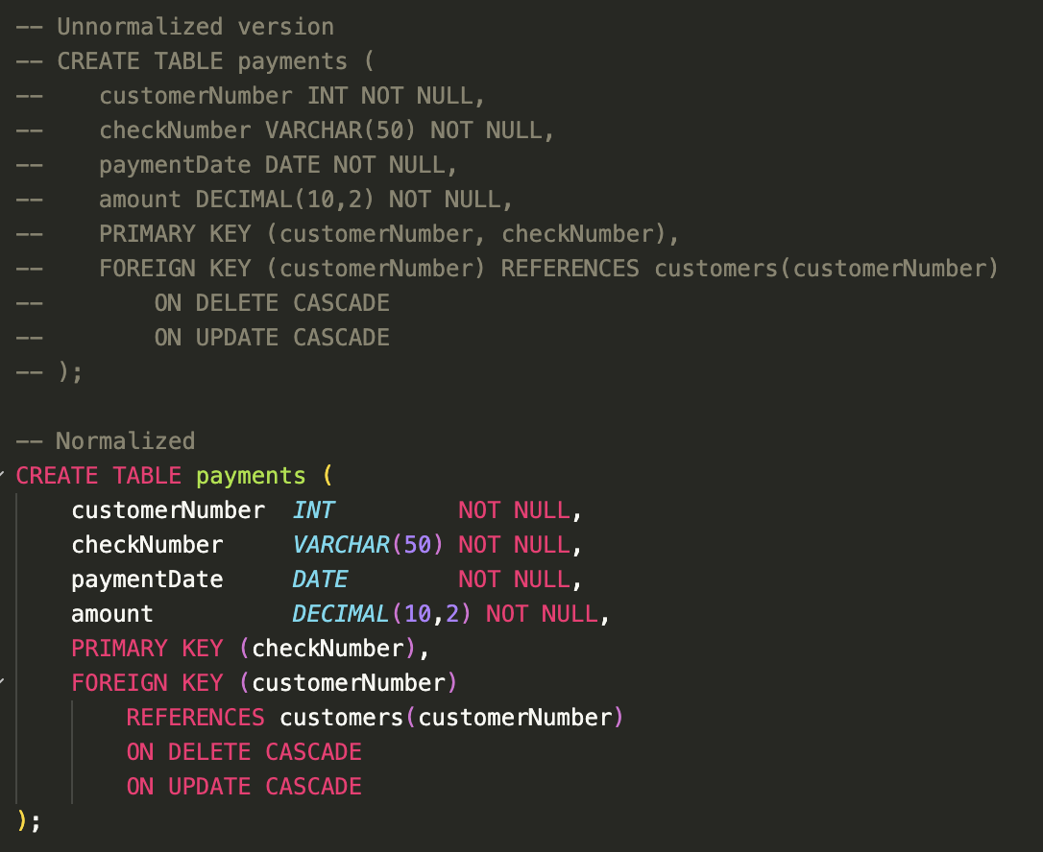
Normalization
The initial payments table’s PK was (customerNumber, checkNumber). This made it 1NF.
1NF:
All columns contain atomic values.
All rows are unique.
There are no repeating groups.
2NF:
The table is in 1NF.
checkNumber is already unique on its own, creating partial dependencies.
The Fix: checkNumber as the PK.
This approach was chosen because checkNumber is unique for each payment.
3NF:
There are no transitive dependencies. (non-key to non-key FDs).
The table is in 2NF.
BCNF:
Every determinant is a candidate key.
The table is in 3NF.

Slide 19
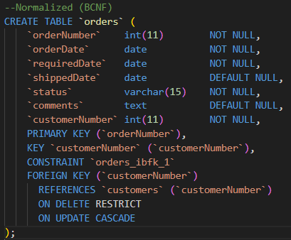
Normalization
The orders table is already in BCNF, because:
1NF:
All columns contain atomic values.
All rows are unique.
There are no repeating groups.
2NF:
The table is in 1NF.
There are no partial dependencies, because the table has a single-attribute primary key (orderNumber).
3NF:
The table is in 2NF.
There are no transitive dependencies (non-key to non-key FDs).
BCNF:
Every determinant is a candidate key.
The table is in 3NF.

Slide 20
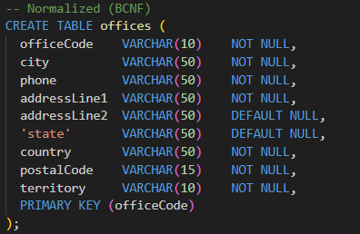
Normalization
The offices table is already in BCNF, because:
1NF:
All columns (city, state, country etc.) contain atomic values.
All rows are unique.
There are no repeating groups.
2NF:
The table is in 1NF.
There are no partial dependencies, because the table has a single-attribute primary key (officeCode).
3NF:
The table is in 2NF.
There are no transitive dependencies. All non-key attributes (phone, territory, location details) rely only on the officeCode.
BCNF:
Every determinant is a candidate key.
The table is in 3NF.

Slide 21
Normalization
The employees table is already in BCNF, because:
1NF:
All columns contain atomic values.
All rows are unique.
There are no repeating groups.
2NF:
There are no partial dependencies, this is because it has only one primary key.
The table is in 1NF.
3NF:
There are no transitive dependencies (non-key to non-key FDs).
The table is in 2NF.
BCNF:
Every determinant is a candidate key.
The table is in 3NF.

Slide 22
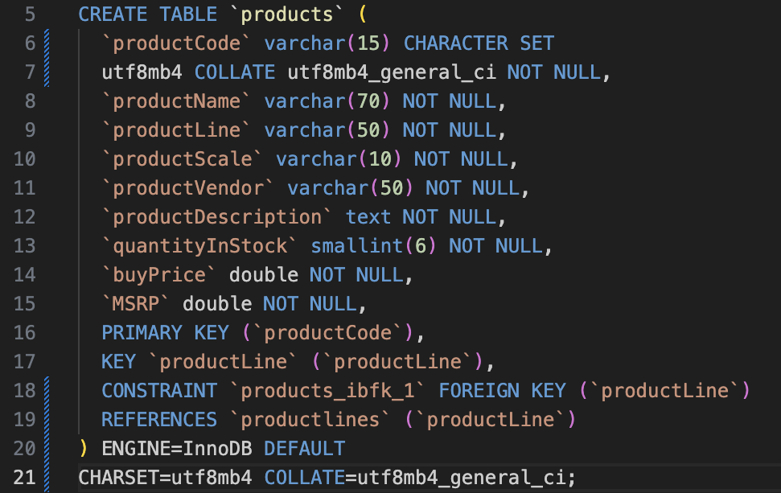
Normalization
The products table is already in BCNF, because:
1NF:
All columns contain atomic values.
All rows are unique.
There are no repeating groups.
2NF:
There are no partial dependencies, because the table has a single-attribute primary key (productCode).
All non-key attributes are fully functionally dependent on productCode.
The table is in 1NF.
3NF:
There are no transitive dependencies (non-key to non-key FDs).
Descriptive attributes depend directly on productCode.
The table is in 2NF.
BCNF:
Every determinant is a candidate key.
The table is in 3NF.

Slide 23
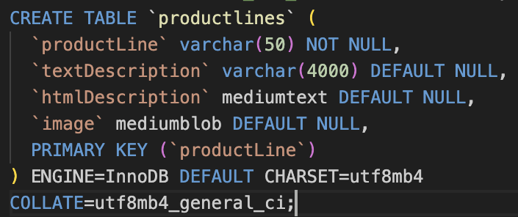
Normalization
The productlines table is already in BCNF, because:
1NF:
All columns contain atomic values.
All rows are unique.
There are no repeating groups.
2NF:
There are no partial dependencies, because the table has a single-attribute primary key (productLine).
All non-key attributes are fully functionally dependent on productLine.
The table is in 1NF.
3NF:
There are no transitive dependencies (non-key to non-key FDs).
Descriptive attributes depend directly on productLine.
The table is in 2NF.
BCNF:
Every determinant is a candidate key.
The table is in 3NF.

Slide 24
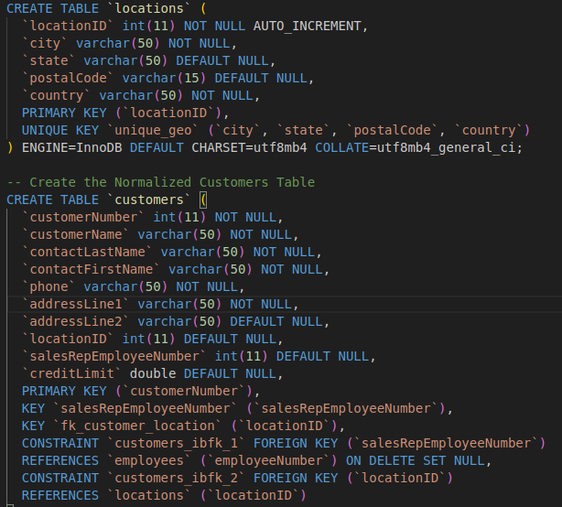
Normalization
1NF:
All columns contain atomic values (e.g., one phone number per cell).
All rows are unique via customerNumber.
There are no repeating groups of data.
2NF:
The table is in 1NF.
Since there is a single-column Primary Key (customerNumber), there are no partial functional dependencies. Every non-key attribute depends on the whole key.
3NF:
The table is in 2NF.
All non-key attributes (e.g., customerName, phone) are now functionally dependent only on the Primary Key (customerNumber) and nothing else.
The geographic attributes live in a locations table, referenced by locationID.

Slide 25
Dataset Description
What does the data include?
The dataset is a synthetic dataset used to simulate business data for a retailer of scale models of cars, ships, etc.
Typical relational tables: customers, products, product lines, orders, order details, payments, employees, and offices which describe sales operations, products, and organizational structure.
What is the source?
The dataset comes from the ClassicModels sample database, originally provided by MySQLTutorial. It can be downloaded directly from places like the MySQL sample DB documentation.
How large is it?
The entire database is about 500 KB in size.
It consists of 8 tables with a total of approximately 3,864 rows and about 59 columns across the schema.
Did you perform any parsing or scraping?
No, we did not perform any automated parsing or scraping. All images used were manually sourced from copyright-free repositories and included as static assets.
Did you use synthetic data?
The ClassicModels dataset is an educational dataset, and all of its data is synthetic.
However, we did not inject any extra data into the database other than testing its functionality.

Slide 26
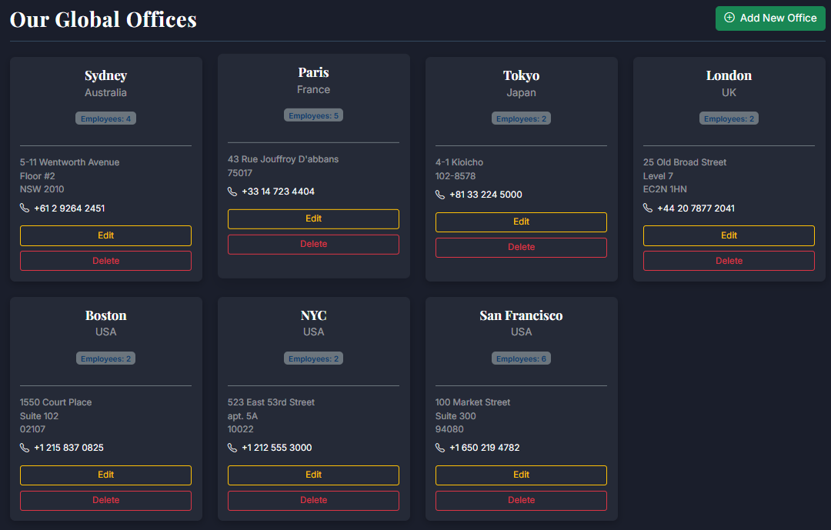
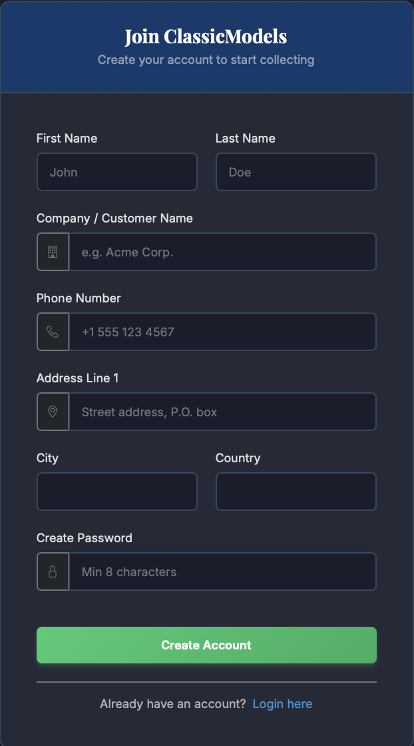
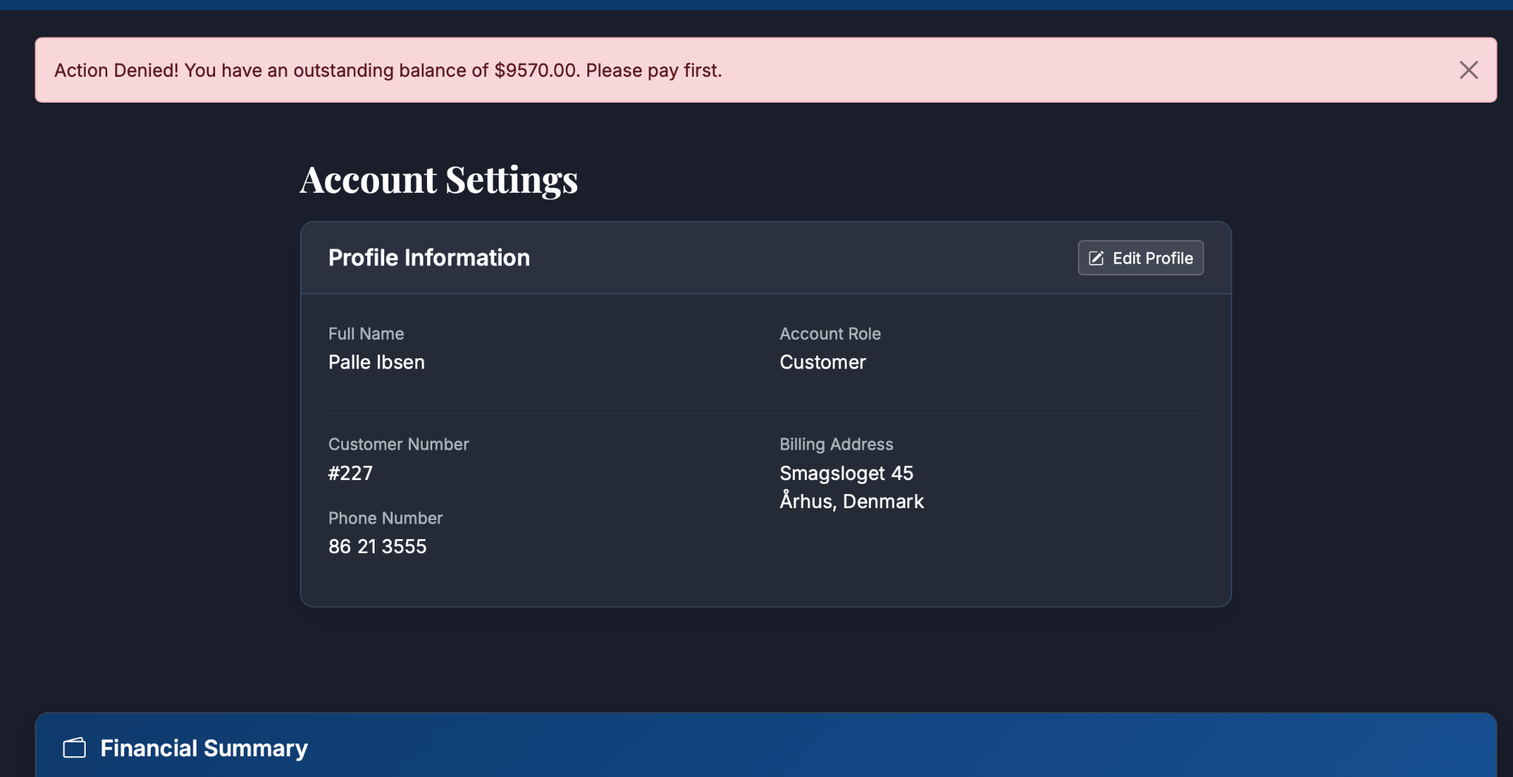
Features

Slide 27
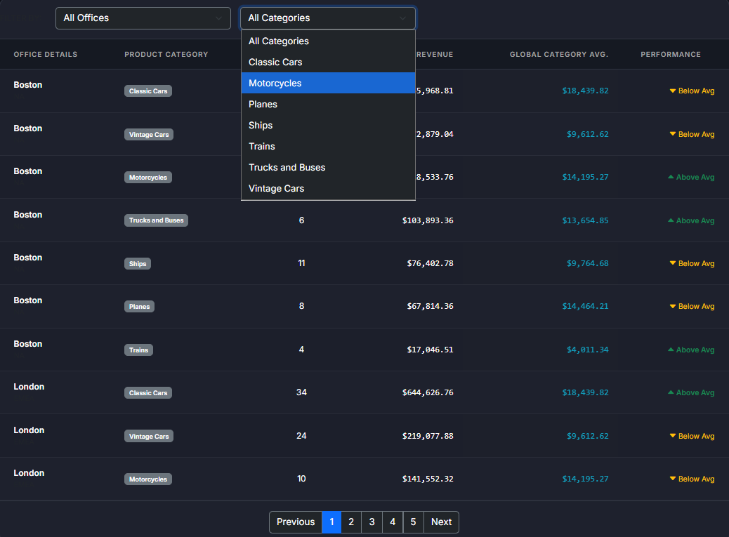
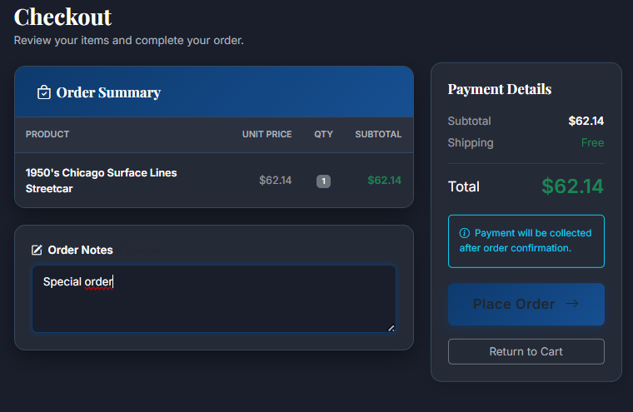
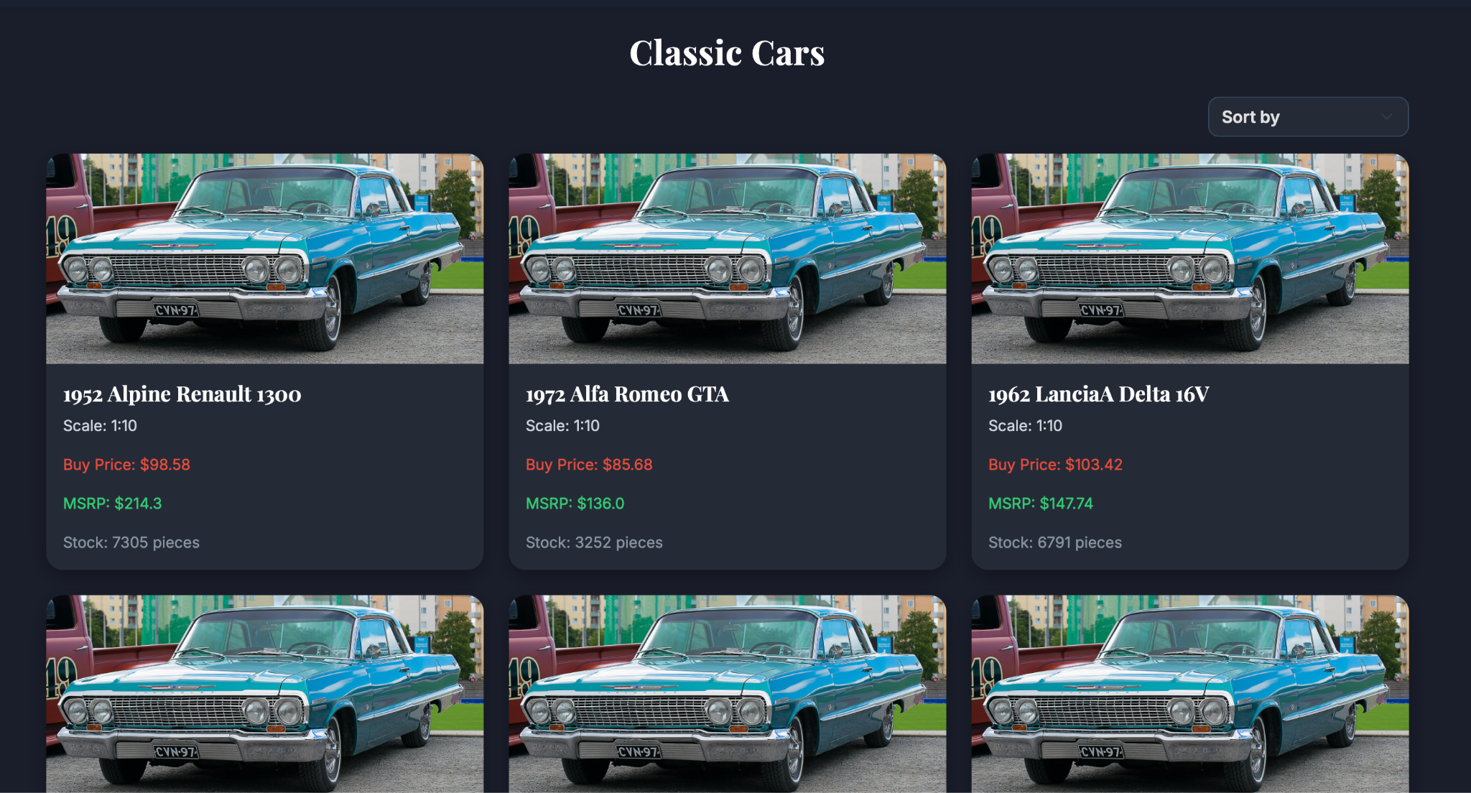
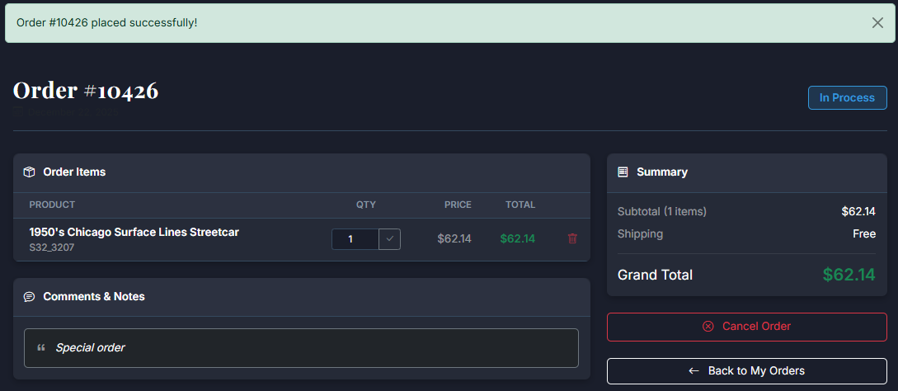
Features

Slide 28




Features

Slide 29

Complex Queries
This complex query is a data analysis function that joins Offices, Employees, Customers, Orders, OrderDetails to link office data to individual sales transactions.
The subquery dynamically calculates the average revenue of other employees in the same office for every row, allowing for a fair, location-based performance comparison. It aggregates revenue for all peers in that office first, then calculates the AVG of those totals.
The inner GROUP BY statement helps to calculate the average revenue by aggregating individual employee
revenue. The outer GROUP BY calculates the total for that
individual sales representative.
It also uses COALESCE to handle NULL values (employees
with no sales appear as $0.00).
Notes:
Kağan

Slide 30

Complex Queries

Slide 31

Complex Queries
This complex query examines the offices in a comparative manner in each product type. It JOINS Offices, Employees, Customers, Orders, OrderDetails , products , productLines.
It utilizes a correlated nested subquery to calculate global average. For each record, the subquery calculates the worldwide average revenue for that category, allowing for performance comparison.
It relies on Dynamic SQL generation to apply user-defined filters and supports Pagination to manage large result sets efficiently.
It uses COALESCE functions to handle NULL values, ensuring accurate financial calculations even for product lines that haven't generated sales in specific regions yet.

Slide 32

Complex Queries

Slide 33

Complex Queries
This query generates a comprehensive performance report by merging workforce data with sales metrics in offices manner.
It joins 5 tables (Offices, Employees, Customers, Orders, OrderDetails) using LEFT JOINS with preserving data integrity.
It uses COUNT(DISTINCT column) to accurately count employees and customers. This is crucial to prevent the "duplicate counting caused by the multi-table joins.
A Scalar Subquery is used in the SELECT clause to dynamically fetch the specific "Manager" or "VP" for each office without complicating the main GROUP BY logic.
It implements a conditional CASE statement to calculate the 'Average Order Value', safely handling potential division-by-zero errors for new offices

Slide 34

Complex Queries

Slide 35

Complex Queries
The "Feel Lucky" query is a complex analytical tool designed to provide a personalized, randomized recommendation for customers. It traverses seven different tables to find a connection between a customer's history, their assigned support staff, and a random product recommendation.
The query prioritizes the city of the Sales Representative assigned to the customer (o.city). If a customer is not assigned a representative, the system dynamically falls back to a completely random office city (off.city). This ensures the user always receives a travel suggestion.
To generate a valid recommendation, the query executes a 7-table join:
Customer → Employee: Identifies the Sales Rep.
Employee → Office: Finds the Rep's home base.
Customer → Order: Looks at buying history.
Order → OrderDetails → Product: Finds the specific items purchased.

Slide 36

Complex Queries

Slide 37

Complex Queries
This complex query is a product-line–level analytics reporting function.
It joins productlines, products, orderdetails, and orders to connect product categories to individual sales transactions.
It uses SUM and COUNT aggregations to calculate units sold, revenue, estimated cost, gross profit, gross margin, and distinct customers per product line.
The inner GROUP BY aggregates transactional data at the product-line level.
The outer LEFT JOIN ensures that product lines with no qualifying sales are still included in the report.
COALESCE is used to handle NULL values so that missing sales data is displayed as zero.

Slide 38

Complex Queries

Slide 39

Complex Queries
This complex query is an employee-performance analytics reporting function.
It joins employees, customers, orders,order_details, and products to connect sales representatives to their specific product-line sales transactions.
It uses SUM aggregations to calculate the total revenue generated by each sales representative per product category.
The WHERE clause filters the dataset to focus exclusively on employees holding the 'Sales Rep' job title.
The GROUP BY aggregates transactional data at the individual employee and product-line levels.
The LIMIT and OFFSET clauses are utilized to implement pagination.

Slide 40

Complex Queries

Slide 41

Complex Queries
This query is an employee productivity and efficiency tracking function.
It performs a sequence of LEFT JOINs starting from the employees table to customers and orders to map the relationship between sales staff and their transaction history.
It uses the COUNT aggregation to calculate both the total number of customers assigned to a representative and their orders.
The WHERE clause filters the dataset to focus exclusively on employees holding the 'Sales Rep' job title.
The GROUP BY aggregates transactional data at the individual employee level.
The HAVING clause serves as a critical filter to choose "unproductive" representatives who have zero successful orders (order_count = 0).

Slide 42

Complex Queries

Slide 43


Testing
The application is functional and secure.
It preserves database integrity as needed.
The database was tested against SQL injections. It handles injections.
The app was also tested against bad data, and it passed this test as well because it validates user inputs server-side (type checks, required fields, etc.) and forbids bad data.
It enforces role-based access control: only employees can manage products and only authorized roles can access reports/analytics pages. We attempted to break into other customers’ orders or employee pages, and failed to do so.
It prevents inconsistent references using normalized tables, as well as database integrity.

Slide 44
Questions
If you have any questions, we would love to answer them!

Slide 45
THANK YOU

